Slide 1
Yakama Nation Outreach
Dr. Francisco Guerrero
Khadijah Homolka

Slide 2
Outline
Warm up question: What is a strong memory from your time in highschool?
Yakama Nation Tribal School: Background on the school’s operations, values, important events and obstacles facing students and teachers (What is a tribally-controlled school?)
What are key takeaways from our visit? (Attendance (Reasons why kids go to the school), Engagement, Teaching strategies)
What are opportunities for engagement?
Different areas of expertise
Hands-on activities (e.g. mental model building)
Cultural relevance
Design activities that leave room for creativity and co-learning with classmates
Activities designed around creative problem-solving
Introduce the students to tangible jobs (natural resources technician with the tribe)
High level approach to topics (broadly focused on how systems work together instead of finer resolution understanding of individual processes)
Our ideas for collaboration!
Keegan needs help with summer school (20 hours of instruction materials needed)
Khadijah’s Ichishkíin language vocab sheet
Margaret teaches aquaculture and earth science material - would be open to co-developing a hands-on activity that is culturally relevant and site specific
Each student group (3-4) would create their own river that includes unique animals, foliage, debris, etc. Then they would combine the river sections into one complete river and they the students would have to determine how the river properties upstream would impact their own river section
Bill Razey would be open to a classroom demonstration/visit

Slide 3
Outline
Warm up question: What is a strong memory from your time in highschool?
Yakama Nation Tribal School: Background on the school’s operations, values, important events and obstacles facing students and teachers (What is a tribally-controlled school?)
What are key takeaways from our visit? (Attendance (Reasons why kids go to the school), Engagement, Teaching strategies)
What are opportunities for engagement?
Our ideas for collaboration!

Slide 4
Warm Up Question
Q: What is a strong memory from your time in high school?

Slide 5

Yakama Nation Tribal School Background
State-Tribal Education Compact and Bureau of Indian Education (BIE) Contract School
8th - 12th grade
Classroom sizes are small ~10-15 students
Traditional Yakama culture and values are the foundation of the school
Hosts school-wide cultural field trips every each like Camas root digging and huckleberry picking
Values tribal government, culture, Ichishkíin, science, math, social studies, physical education, drumming and singing
Supports peer-learning and multidisciplinary classes
Comply with a BIE mandated standardized yearly exam

Slide 6
Obstacles in the Classroom
Attendance
Student homelessness
Incarcerated caregivers
Lack of transportation
Needing to care for younger siblings or grandparents
Struggle making material culturally relevant and interesting
Special education → reading and writing
Internet connectivity and lack of computer access
Teachers are overworked, underpaid and underfunded
Notes:
Sporadic attendance or missing school can because of a laundry list of issues: homelessness, incarcerated caregivers, domestic violence, lack of transportation, needing to care for younger siblings or grandparents. All systemic issues of poverty that are common across many reservations because of colonialism

Slide 7
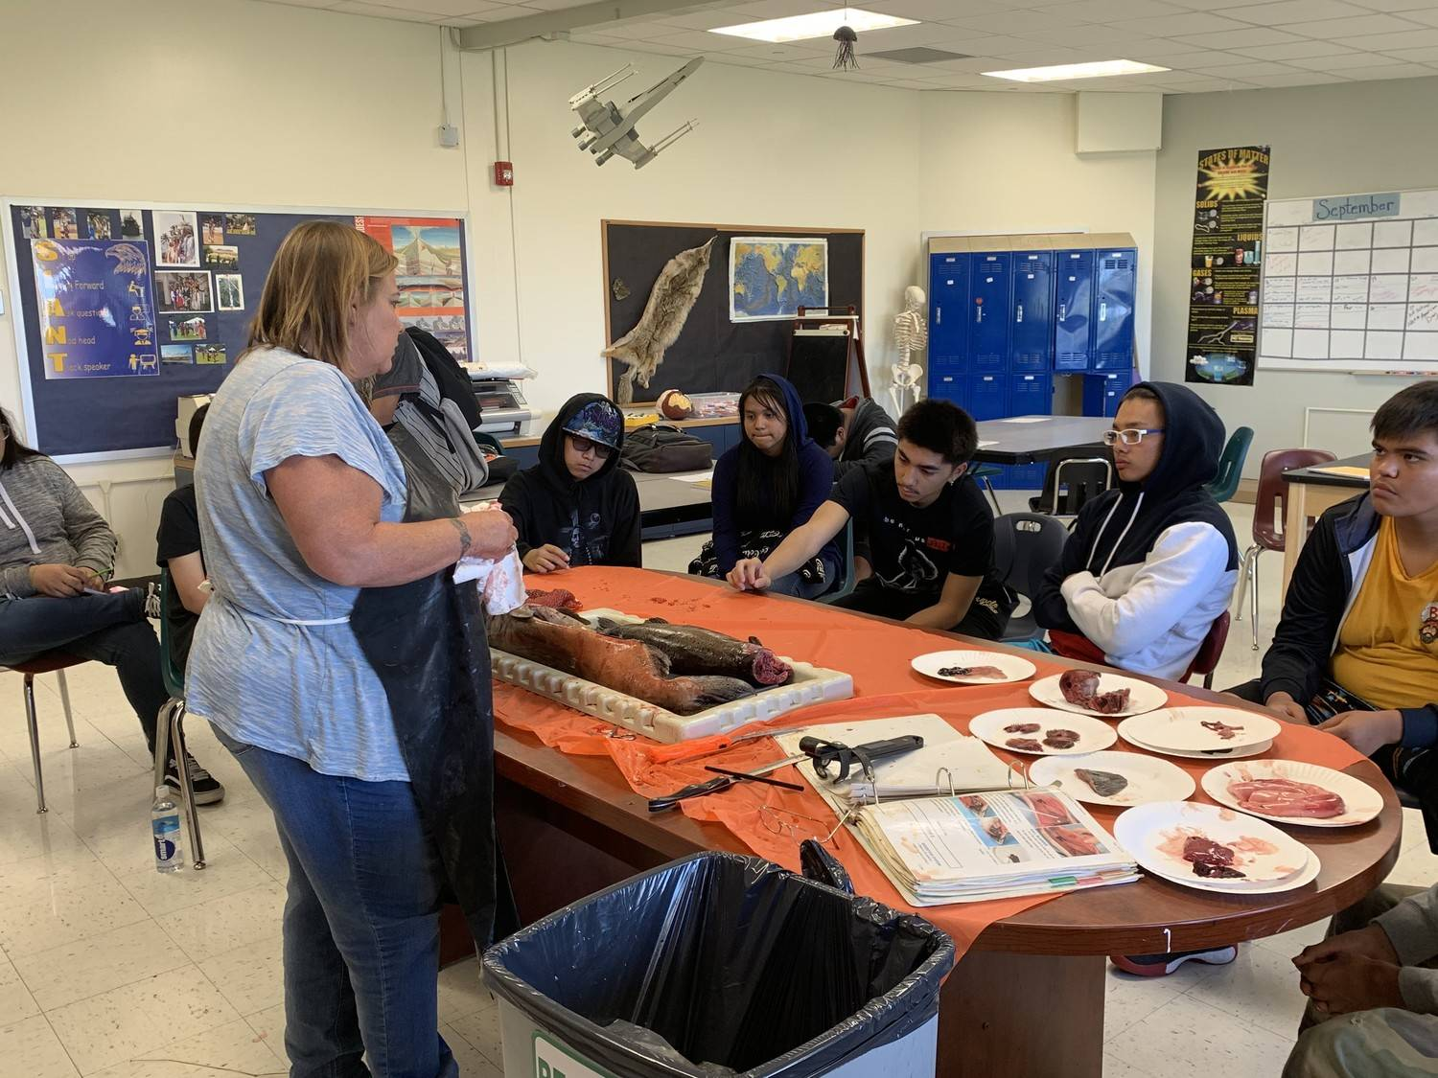
How Can We Overcome These Obstacles?
Designing cooperative projects
hands-on activities with problem solving components
Incorporation of strong visual aids
Leaving room for creativity and self-expression
Approaching the same subject from multiple angles
High level approach to complex topics
Margaret Carters class participating in a pregnant shark dissection

Slide 8

We have some awesome opportunities for collaboration!

Slide 9
Idea #1: Ichishkíin + Ecosystem Processes
Keegan Livermore’s Summer School
Area where he needs the most help (20 hours of instructional material)
Liked KH’s ecosystem processes vocabulary sheet idea
Goal: teach students vocabulary words to describe places where they have hunted, gathered, fished, etc.
KH Responsibilities
Use Sahaptin dictionary to translate vocab words
Create illustration for each vocab word
Compile pronunciation recordings from UW hosted Sahaptin language site

Slide 10
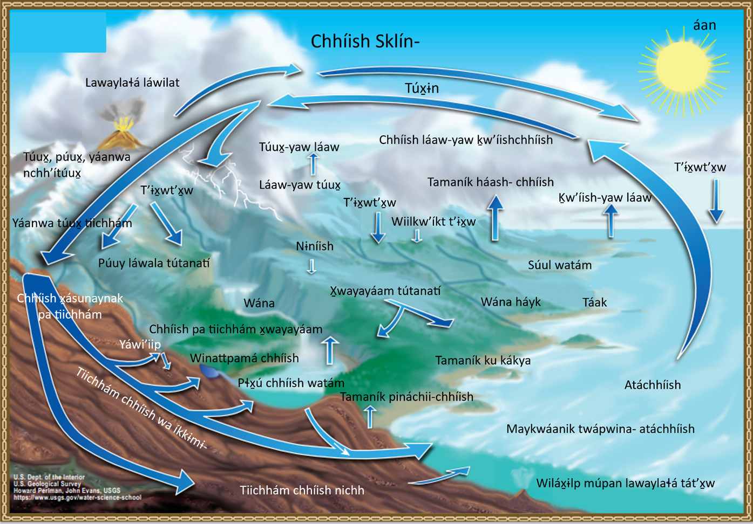
Heritage University – Agnes Meninick
Notes:
https://heritage.edu/the-science-of-tradition/

Slide 11
Summer Ambassador for the Yakama Nation Tribal School
An opportunity for Agnes to create another visual product in Ichishkíin language.

Slide 12
Resources
Yakama Nation Climate Action Plan
“Land of the Yakamas” Film
Restoration Stories
Ecological Concerns: Water Quality
Heritage University Student Research Posters

